Slide 1


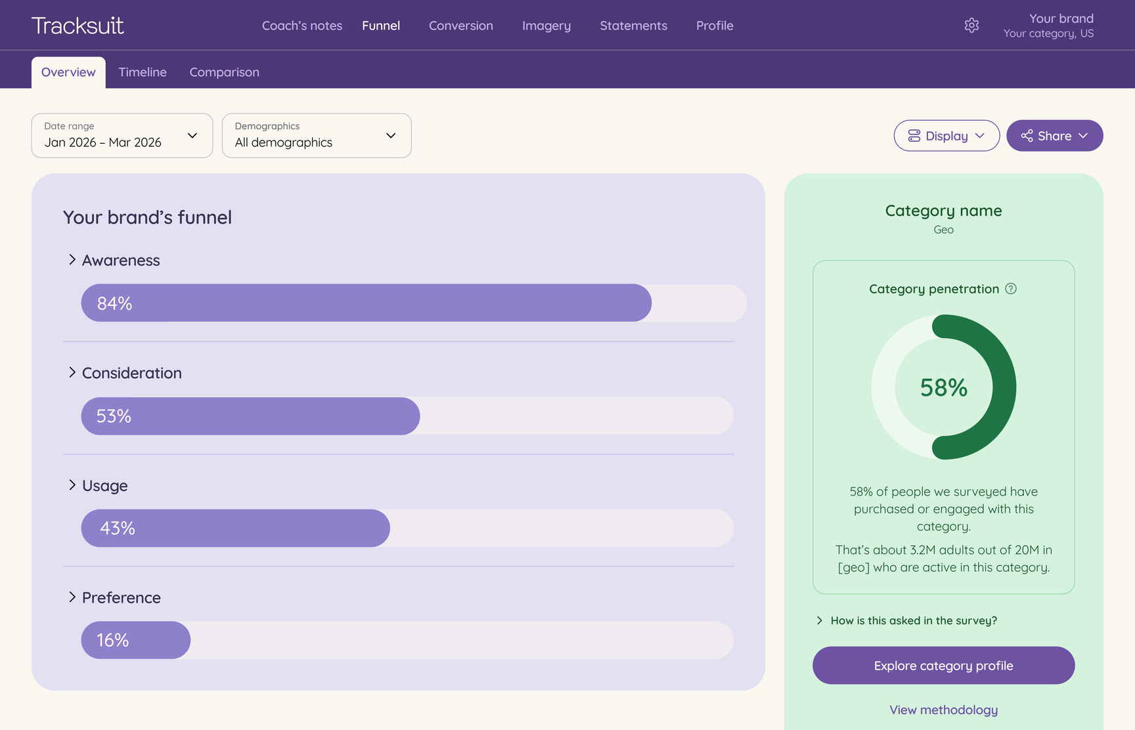

Always-on brand tracking,
built for marketers and agencies
Tracksuit helps you prove great brands build great businesses
We've reimagined brand tracking for today's brands. Easily track awareness, consideration, preference and brand associations, and compare results against competitors over time.
The result: you can measure, understand and communicate the value of brand.

Slide 2
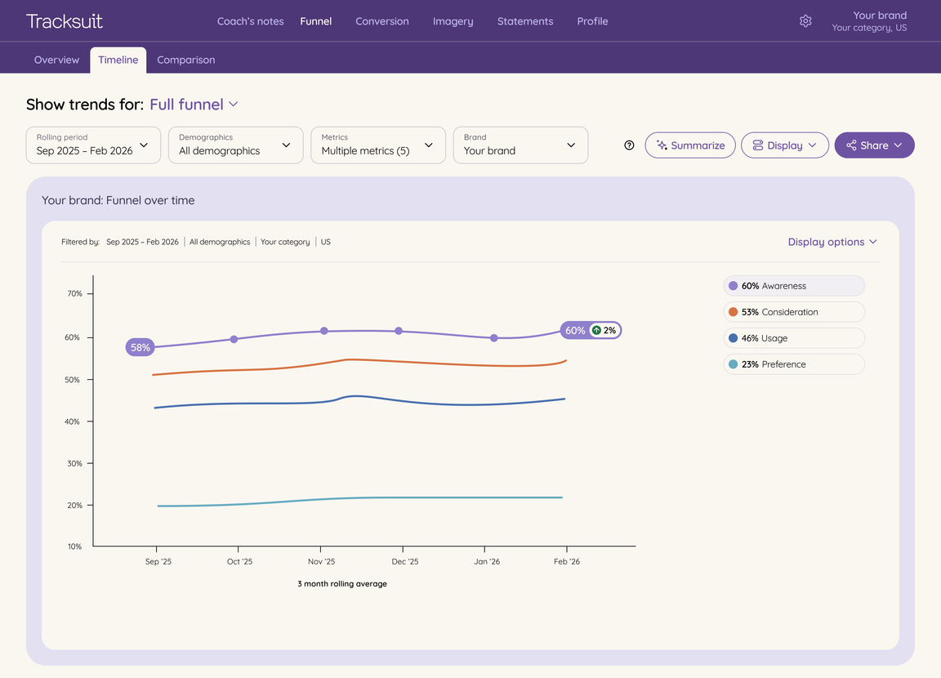
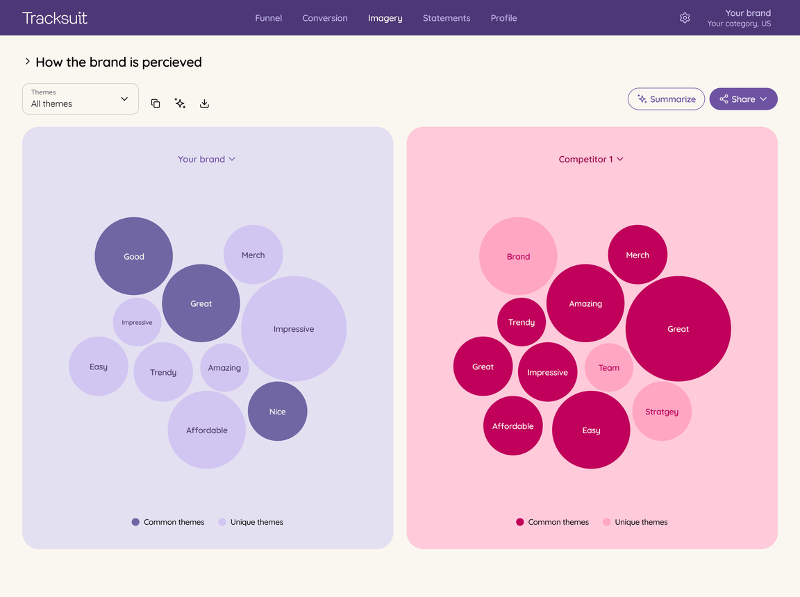
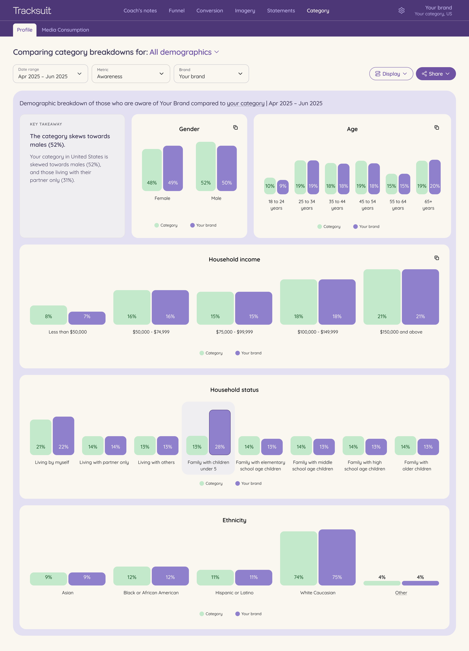


Brand tracking that drives outcomes
How it works
Every day, we survey real-life humans to measure and understand your brand health.
  Enterprise research standards: real, verified humans from the world's largest panel provider
  Statistical confidence you can trust: 3.1% - 3.9% margin of error (the industry gold standard)
  Sample size: 2400 - 4000 responses annually
  Always-on intelligence: continuous data collection updated in your dashboard monthly
  Enterprise research standards:
  Statistical confidence you can trust:
  Sample size:
  Always-on intelligence:
Proof points every marketer needs
Back big
decisions
Understand your category inside out
Tracksuit turns your brand-building into clear, defensible evidence that consistent investment pays off, so you can justify every dollar of brand spend with confidence.
Whether that’s launching a campaign, entering a new market, planning a rebrand or presenting a new strategy to the board.
Get inside the minds of your category buyers and use these insights to spot white space, find your people, and build strategies that actually resonate.
Sick of expensive, static reports delivered once a year?
Ask your agency to set up a call with Tracksuit.

