Slide 1


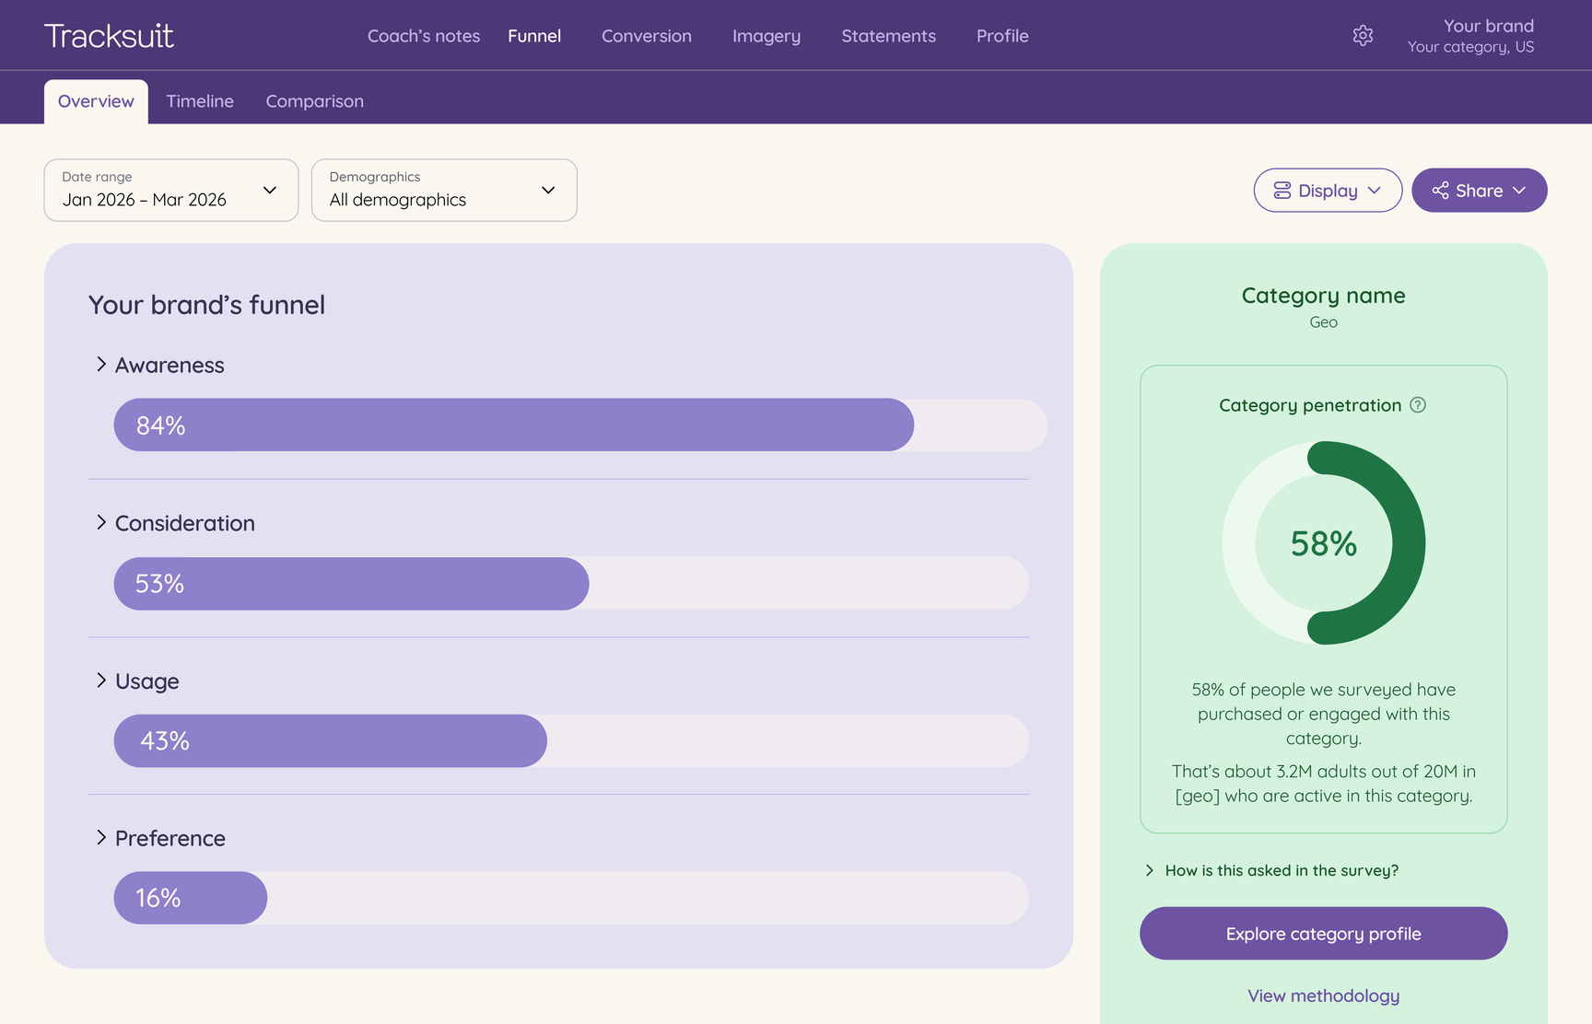

Always-on brand tracking,
built for marketers and agencies
Tracksuit helps you prove great brands build great businesses
We've reimagined brand tracking for today's brands. Easily track awareness, consideration, preference and brand associations, and compare results against competitors over time.
The result: you can measure, understand and communicate the value of brand.

